Slide 1
PLANT DISEASE DETECTION SYSTEM
Abhishek Mahawadi (0827CS171005)
Anand Barhanpurkar (0827CS171022)
Anshul Dhanotiya (0827CS171030)

Slide 2
INTRODUCTION
Basically, the project deals with the identification of disease in plants/crops in the early stages, so as to prevent the spread of the disease at extreme levels. As an introduction to the project, we will be providing a leaf image as an input and using Machine Learning will be training the dataset.

Slide 3

PROBLEM STATEMENT
We, humans, have a Nervous System through which we can easily identify things by just looking at them, but think how a machine/robot will do that?

Slide 4
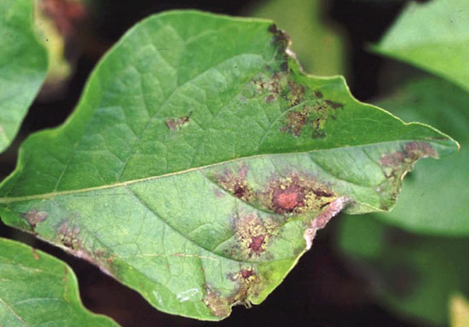
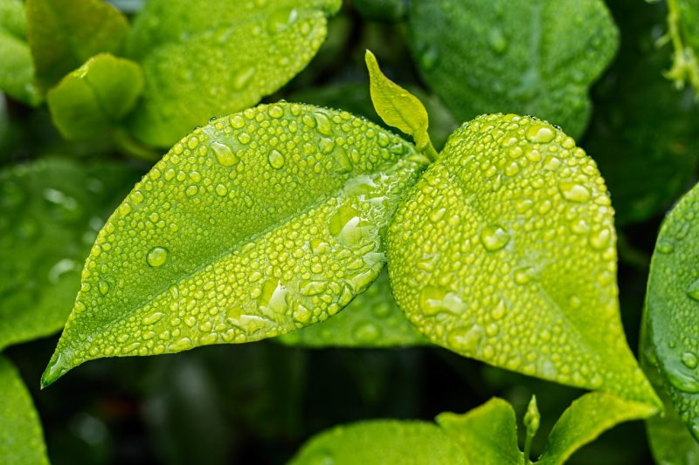
OUR SOLUTION
This could be possible with the help of Deep learning.
Through deep learning, we can easily provide this ability to a machine by extracting features from the provided images using the Convolutional Neural Network (CNN) Model.
Diseased Plant
Healthy Plant

Slide 5
TECHNOLOGY STACK
Python
Deep Learning
Libraries: - Numpy, Keras
Tool(IDE):- Google Colab
Dataset :- Kaggle

Slide 6
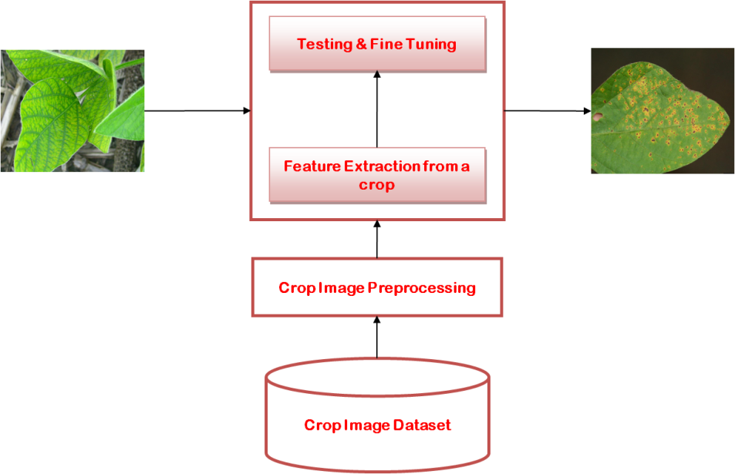
PROCESS FLOW

Slide 7
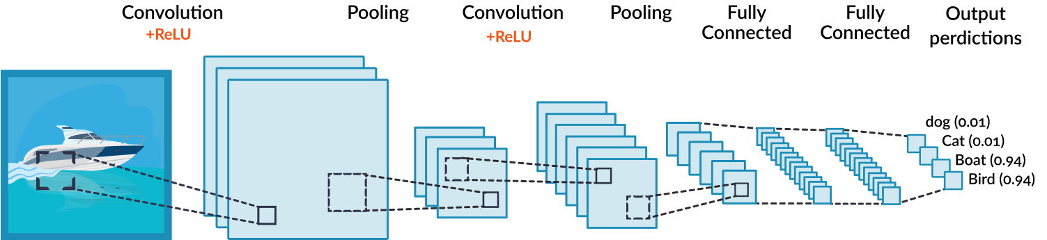
PROCESS FLOW
CNN Model

Slide 8
Thank You

